Slide 1
Business Intelligence System for Global Sales Analysis and Customer Segmentation
Final Project Presentation
[AT 82 - DSAI] Business Intelligence and Analytics (BI&A)
Presented by Group 7:
Nathas Sungworawongpana (st124323),
Wut Yee Aung (st124377),
Kyi Thin Nu (st124087)
18. April. 2024 (Thursday)

Slide 2
Application Domain
Business Intelligence System for Global Sales Data Analysis
Decision Support System for the Customer Segmentation

Slide 3
Data
For the data sources, we will use the dataset that is provided from the paper, “Online Retail Dataset II (Chongkolnee R. et. al. (2023))”.
The dataset contains 2 years of sales data (Year 2009-2010 and Year 2010-2011) including total 1,067,371 samples and 8 features.
Features:
Invoice
Stock Code
Description
Quantity
InvoiceDate
Price
CustomerID
Country
Data Source

Slide 4
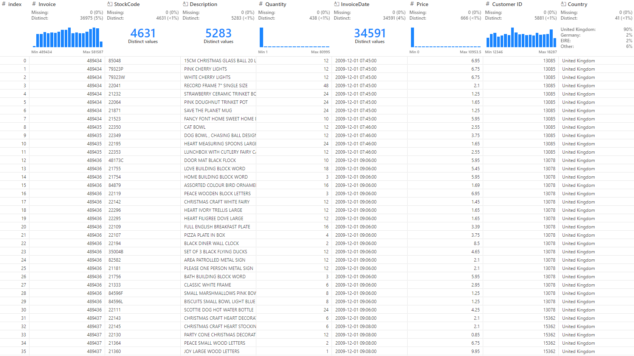

Slide 5
RFM Model Implementation
Recency score: Calculated as the time difference, in days, between each purchase date and the end date of the quarter. This approach enables quarterly analysis.
Revenue calculation: Determined by multiplying the quantity and price for each entry.
Data grouping: Entries were grouped into quarterly time frames spanning from 2009Q4 to 2011Q4.
For each quarter:
Recency score: Selected from the most recent order, identified by the lowest date difference.
Revenue score: Computed as the sum of revenue for each customer and quarter.
Frequency score: Derived from the count of distinct invoices received by each customer during the quarter.

Slide 6
RFM Scores and Segmentation
Scoring Methodology:
We assign discrete scores ranging from 1 to 5 for recency, frequency, and monetary value, based on five quantiles.
These scores are combined into a three-digit score, with each digit representing R, F, and M scores, respectively.
Segmentation:
Among the possible 125 distinct scores, we assign them into 5 segments according to predefined groups:
Champion: High scores across all three dimensions (e.g., 555, 554).
Loyal Customer: High scores in some dimensions, indicating consistent engagement (e.g., 543, 444).
Need Attention: Moderate scores in certain dimensions, suggesting potential for improvement (e.g., 525, 434).
Losing: Low scores across multiple dimensions, indicating declining engagement (e.g., 331, 221).
New Customer: Initial engagement, reflected in specific score combinations (e.g., 512, 411).

Slide 7
BI Dashboard
max growth
Sales Performance Dashboard
Customer Dashboard
Customer Segmentation Dashboard

Slide 8
Sales Performance Dashboard
BI Dashboard
max growth
Sales amount KPI according to selected date, period and region
Total sales amount
Total Sales Trend
Sales by region
Top 10 countries by sales amount
Top 10 product by sales amount

Slide 9
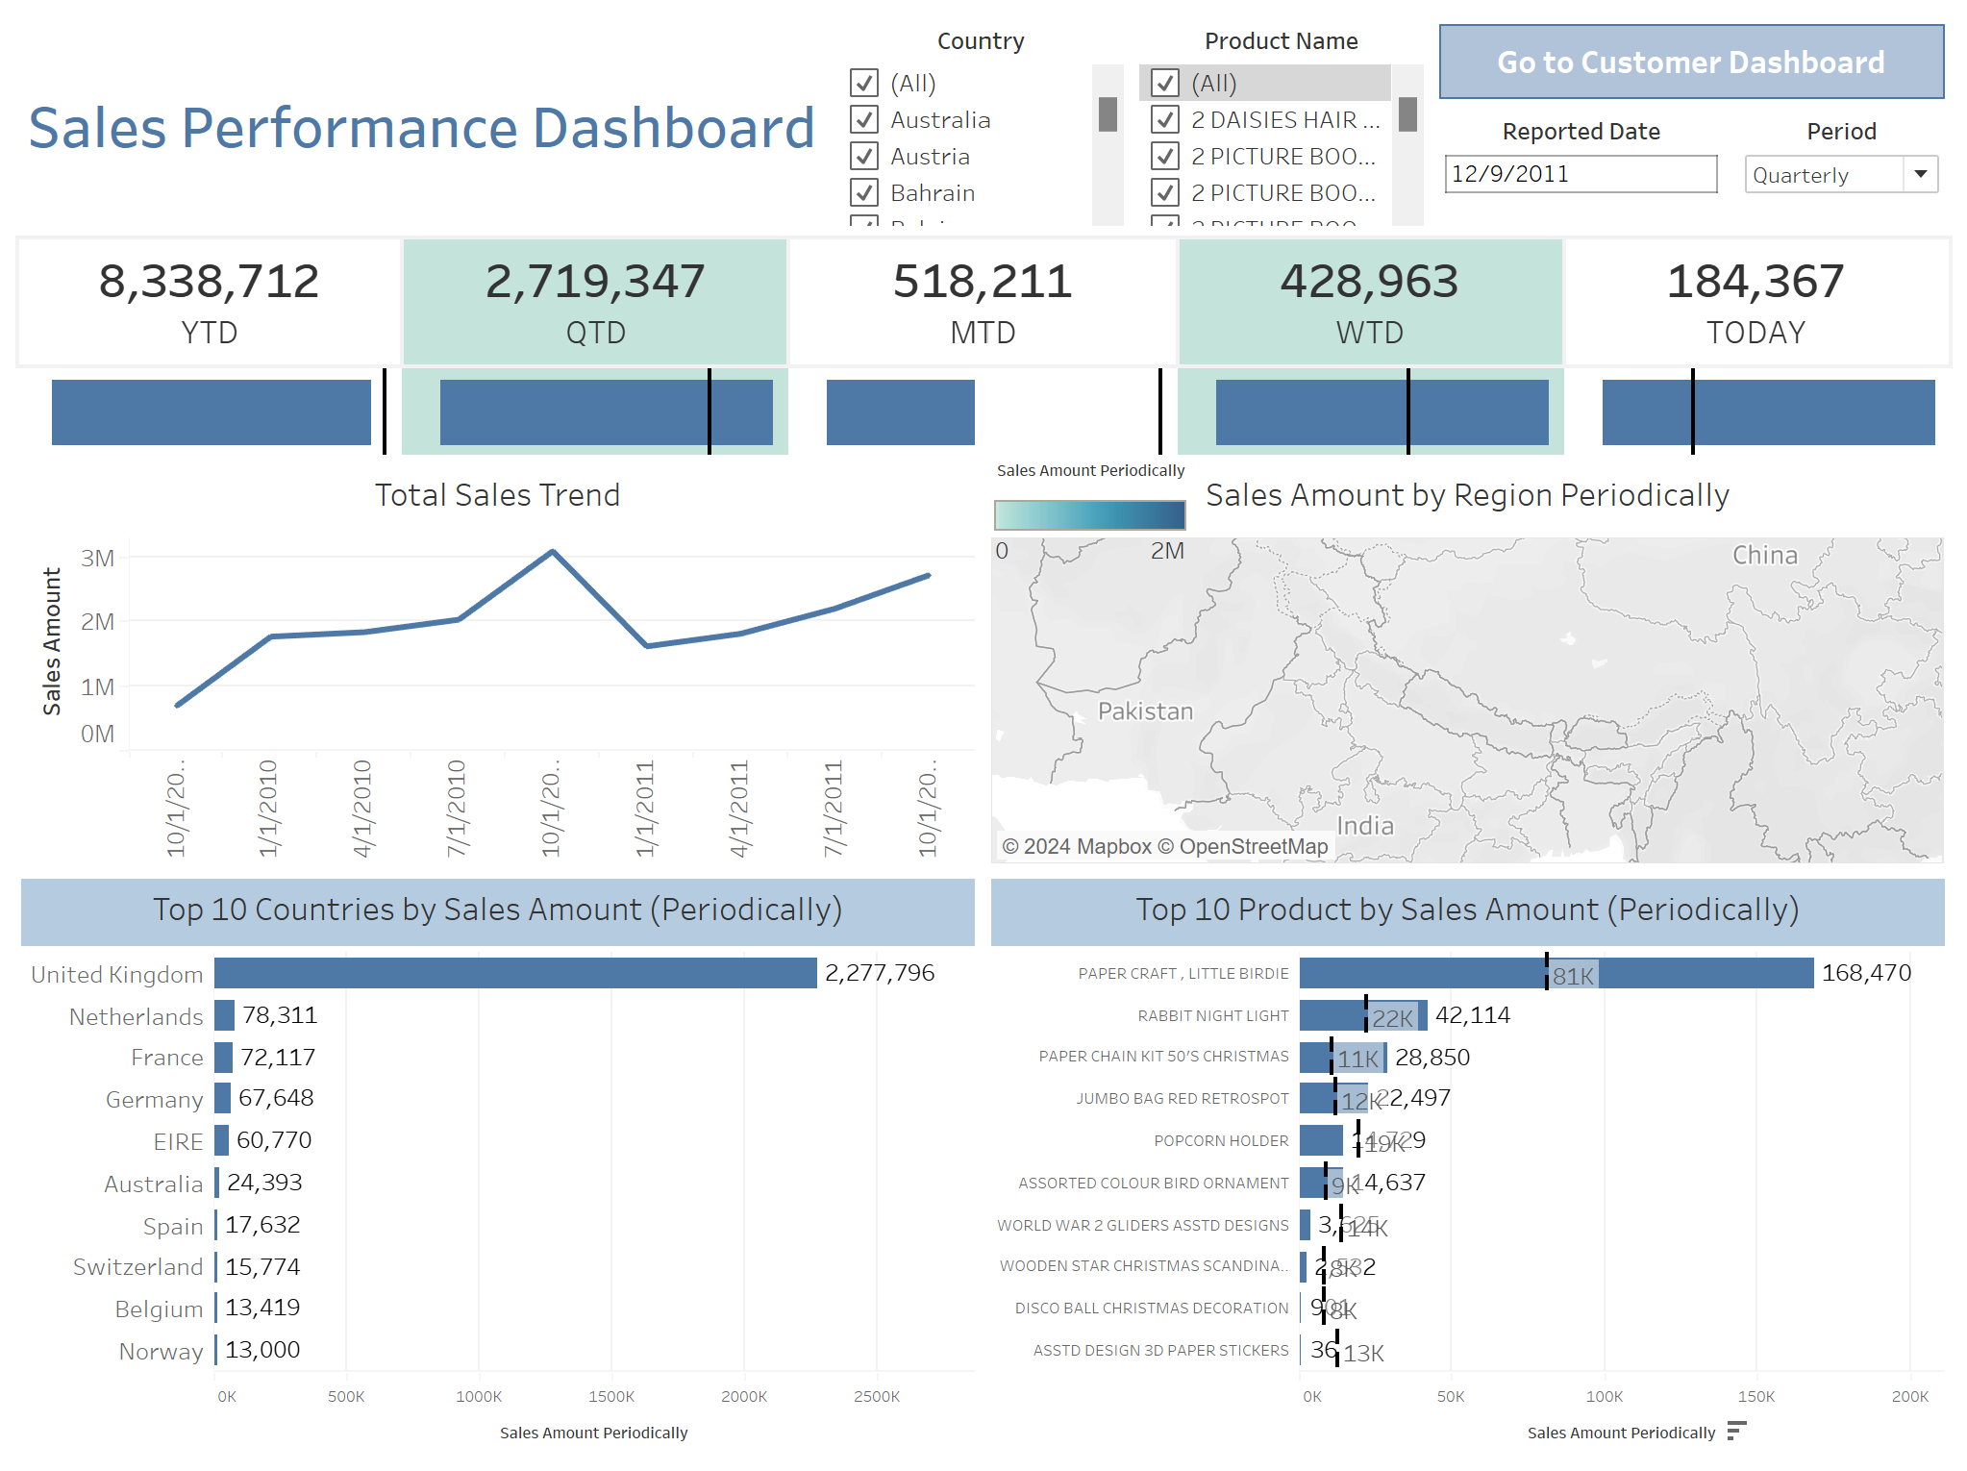

Slide 10
Customer Dashboard
BI Dashboard
max growth
Customer KPI according to selected date and period
Active user count
Quarterly Active vs Churn
Top 10 countries by Customer count
Customer retention rate
Customer retention trend

Slide 11
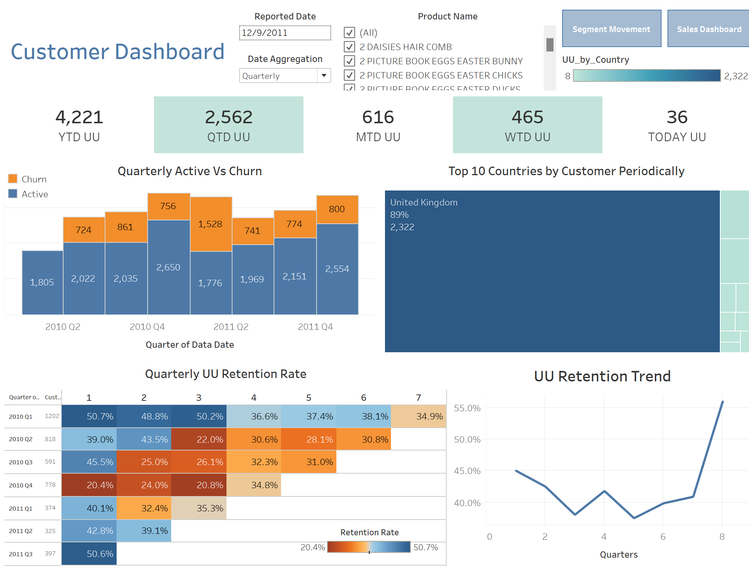

Slide 12
Customer Segmentation Dashboard
BI Dashboard
max growth
Quarterly UU with Segment
UU Segment Movement

Slide 13
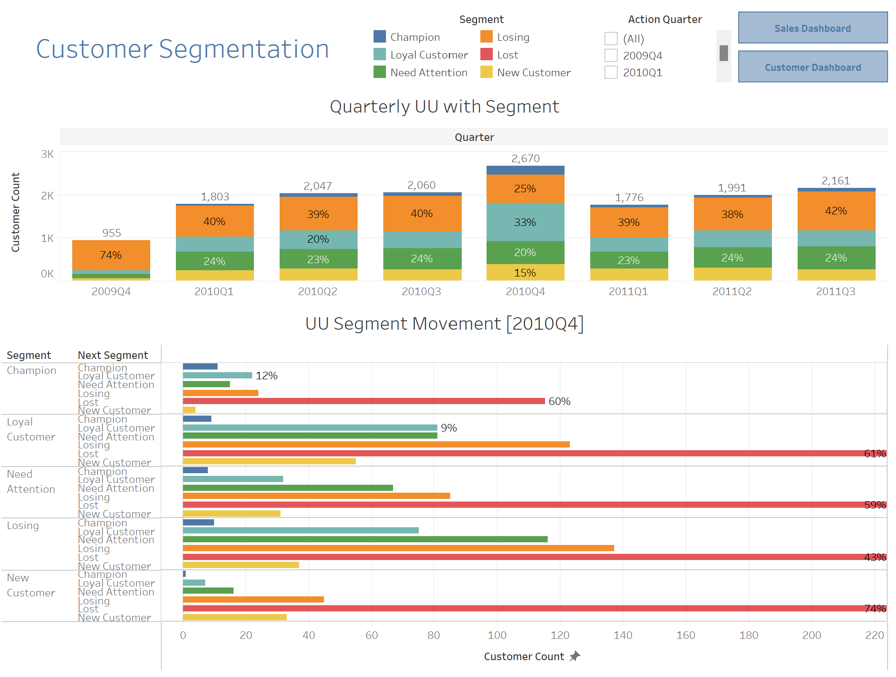

Slide 14
Conclusion
BI system can provide either traditional or interactive reporting to assist organization in decision making.
Enables the analysis of historical data to address business questions.
Predictive and Prescriptive analysis support data-driven decision-making system for customer segmentation.

Slide 15
Thank You

